Slide 1


Uganda Bureau of Statistics
Producer Price Index-Agriculture
October – December 2021
Press Release
March 2022
Ronald Ssombwe
Tel: 0775-226754 : Email-ronaldssombwe@ymail.com
Principal Statistician
Agriculture and Environment Statistics

Slide 2
Uganda Bureau of Statistics
Content
Overview of the PPI-A
PPI-A 2019-2021
PPI-A Oct-Dec 2021

Slide 3
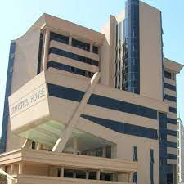
Introduction
Production of the PPI-A
The Producer Price Index –Agriculture is one of the indices produced and disseminated by the Uganda Bureau of Statistics (UBOS) under the UBOS Act No. 12, 1998.
Users
Main users of the index include; Ministry of Agriculture, Animal Industry and Fisheries, FAO, Ministry of Finance, Planning and Economic Development , Central Bank, Ministry of Trade, Media, the Higher Local Governments, Non-Government Organisations, Private sector involved with trade and agro-industrialization, Research & Academics, among others.
UBOS Strategic goal.
Increased use of statistics for development results.

Slide 4
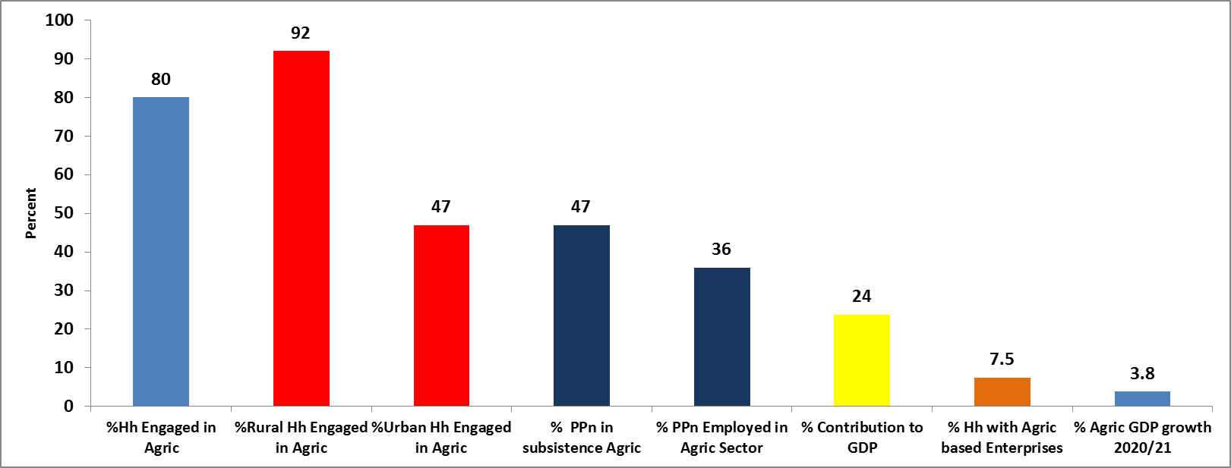
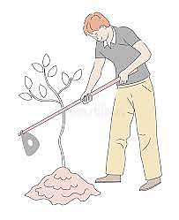
Background: Key Agricultural Statistics

Slide 5
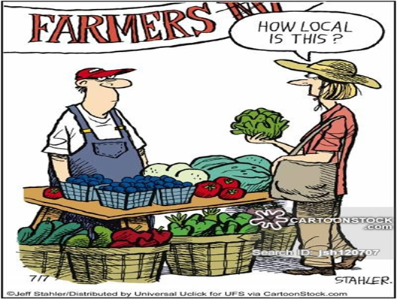
Purpose of the Producer Price Index
Produced to show the pattern and level of the average farm-gate price received by farmers/producers for a unit of primary agriculture products over time with reference to a base period.
To measure producer price inflation which the average change in the selling price received by farmers over a period of one year.
To monitor policy outcomes and decision-making for development.

Slide 6



Definition of Producer Price / Farm-gate price
The average basic price received by farmers in the domestic market for a specific primary agricultural commodity available at the farm or at a selling point near their residences (e.g. Farmers’ market)—ISIC & OECD
The producer price /farm-gate price and does not include taxes, delivery and transport costs/charges.
The producer prices are collected monthly by a team of market monitors based in the local areas.

Slide 7
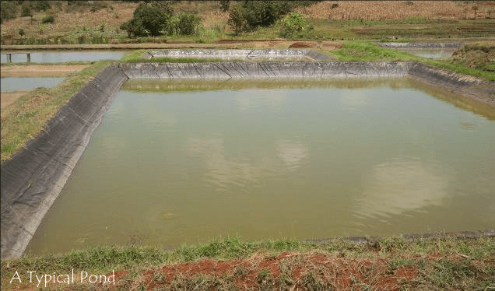
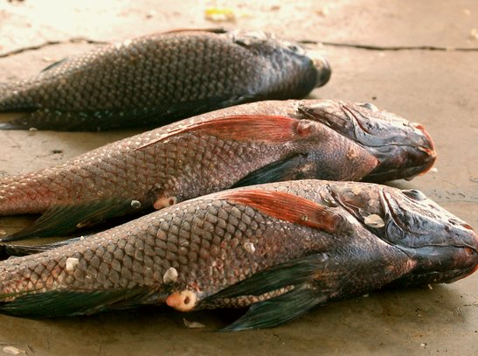
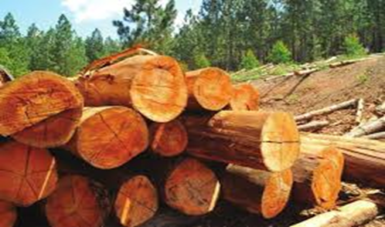
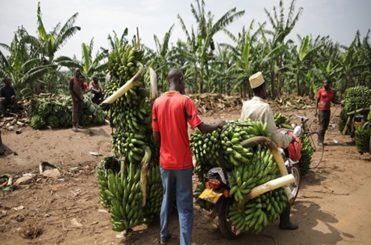
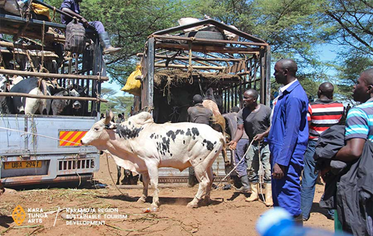
PPI-A Variable Coverage
Crops Production - Food & Cash crops
Fish Production - Catch & Aquaculture
Animal production-Animal, birds, products
Forestry & Logging

Slide 8
PPI- Agricultural Basket
International Standard Classification Group |  | Examples
00 | Growing of Cereals | Maize, Millet, Sorghum
01 | Growing of Leguminous crop | Beans, Peas
02 | Growing of oil seeds | G. nuts, Soya, Sim-Sim, Palm-oil
03 | Growing rice | Super , Kaiso
04 | Growing leafy or stem vegetables | Cabbage, Gobe, Spinach, Sukuma, etc
05 | Growing of fruit bearing vegetables | Tomatoes, Egg-plants, watermelon, Pumpkin, Bitter tomatoes, Cucumber
06 | Growing of bulb or tuberous vegetables | Onions , Carrots
07 | Growing of roots tubers | Sweet Potatoes, Irish, Cassava, Yams
08 | Growing sugarcane | Sugar-cane for making sugar
09 | Growing tobacco | Tobacco leaves
10 | Growing of fibre crops | Cotton
11 | Growing of tropical fruits and subtropical fruits | Jackfruit, Pineapple, Avocado, passion
12 | Banana and plantain | Banana(food), Sweet bananas
13 | Growing of citrus fruits | Oranges, Lemons, Tangerines
14 | Growing of beverage crops---Mainly Cash-crops | Coffee, Tea, Cocoa, Vanilla
19 | Raising of Cattle | Indigenous and Exotic Cows, Bulls, Heifer, Steers
20 | Production of raw milk | Unprocessed Milk
21 | Raising of sheep and goats | Local and exotic Sheep, Goat, Ram
22 | Raising of swine/pigs | Boar , Sow
23 | Raising of poultry | Hen, Cock, Ducks, Turkey,
24 | Production of eggs | Local and Exotic eggs
25 | Raising of other animals | Rabbits
26 | Bee keeping and production of honey and beeswax | Honey
27 | Forestry and Logging products | Firewood, kalitunsi, timber, fencing & Rafter pole
28 | Fresh and Aquaculture fisheries | Tilapia, Nile-Perch, Silver, Catfish
A basket of 95 Commodities produced in the domestic economy

Slide 9
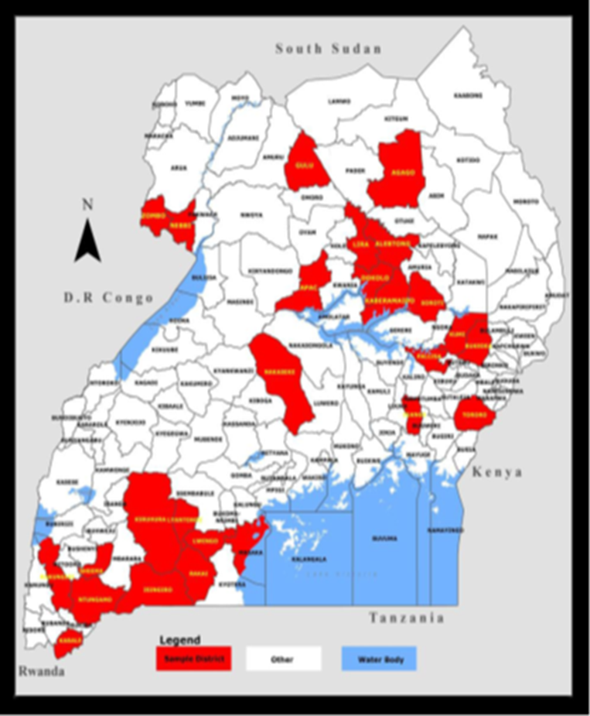
Data sources
Details on sources
21 Crop Markets
23 Livestock Markets
21 sources for Cash-crop prices
10 sources for Fish & Aquaculture
15 Forestry product providers
Data collection is conducted monthly by market monitors using paper questionnaires.
44 Markets

Slide 10
Data sources Location
Central | Eastern | Northern | Western
Masaka | Soroti | Lira | Rukungiri
Rakai | Bukedea | Alebtong | Isingiro
Lyantonde | Palissa | Apac | Sheema
Lwengo | Tororo | Dokolo | Kabale/Rubanda
Nakaseke | Iganga | Agago | Kiruhura/Kazo
 | Kaberamaido | Gulu | Ntungamo
 | Kumi | Zombo & Nebbi

Slide 11
Methodology
Base Period is 2016/17
Agricultural commodity Divisions(ISIC Rev 4) and Weights(SUT)
Formula: modified Lasperyers Index approach-fixed weights in base period
Price-per-kg is the standard data used for most of the basket items with quarterly revisions.
Division | Weight
Crop Production | 727.89
Animal Production | 154.11
Fish & Aquaculture production | 80.72
Forestry and Logging | 37.27

Slide 12
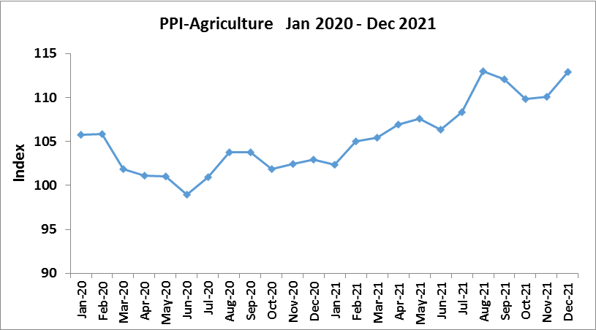
Trend of Farm-gate Prices 2020 -2021
A Mar-June 2020 decline – Covid-19 lockdown, reduced demand for items caused by limited access to the rural areas by buyers. Most prices of items reduced considerably as farmers competed for buyers.
Since June 2020, famer prices has had an upward trend to Dec 2021

Slide 13
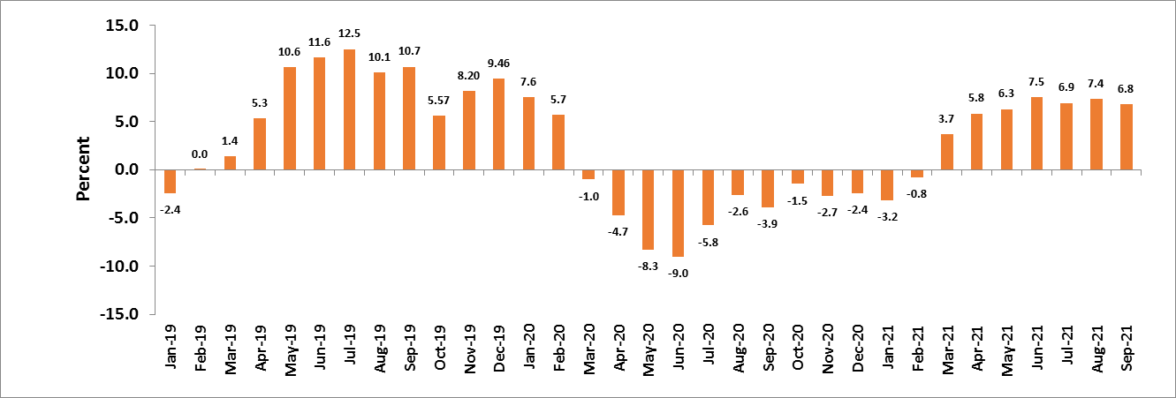
Pattern of PPI-A Inflation 2019 -2021

Slide 14
PPI-A Inflation 2018-2021
It is normal that the Inflation is positive and negative due to the cob-web structure of agricultural prices.
However, when a country experiences stress/bottlenecks in agricultural production and supply , inflation outcome may reflect differently.

Slide 15
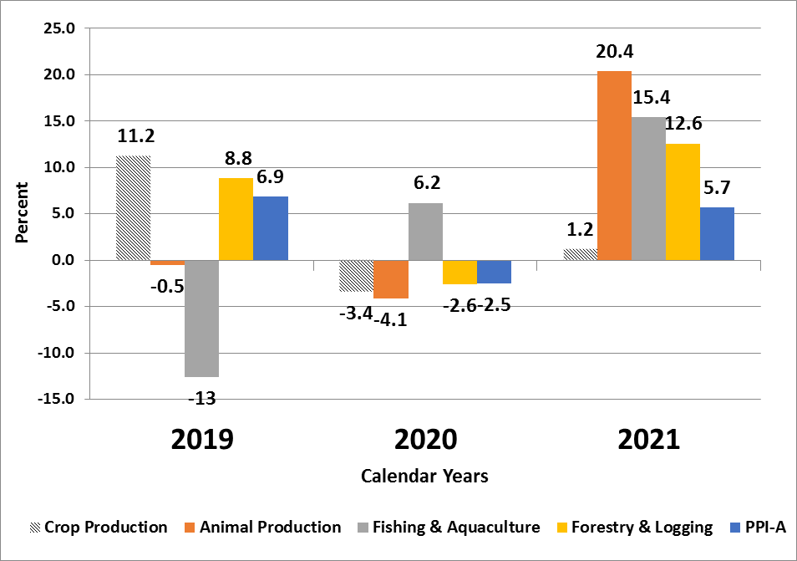
PPI-A Inflation 2019 – 2021 by Division
The overall change in average prices for the Agricultural basket increased by 5.7 % in 2021.
In 2020, due to the Covid-19 lock-down farmers prices for the agricultural items basket declined by 2.5%

Slide 16
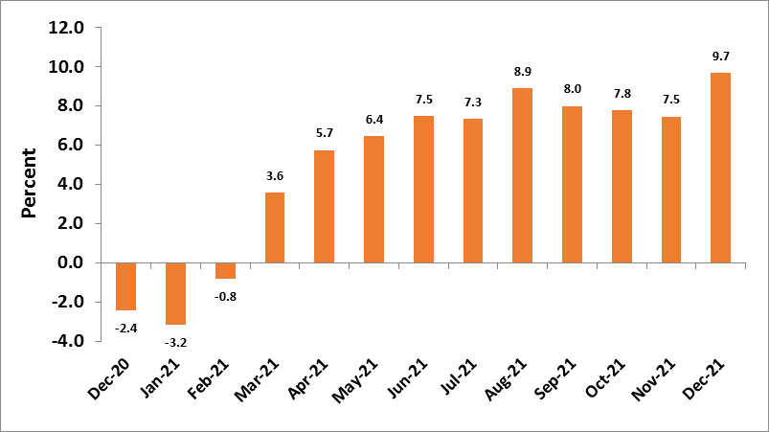
PPI-A Annual Inflation Dec-2020- Dec 2021

Slide 17
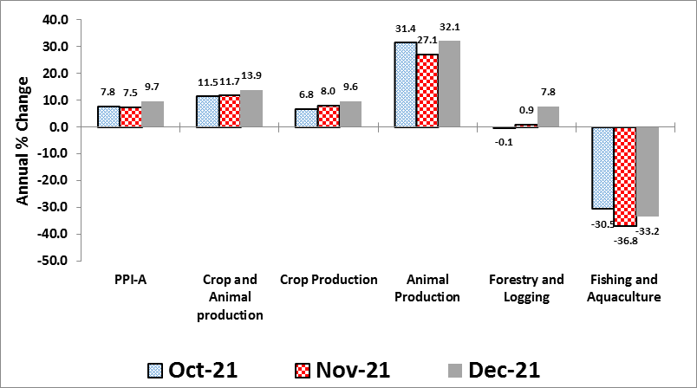
Annual Price Inflation Oct – Dec 2021 by Division

Slide 18
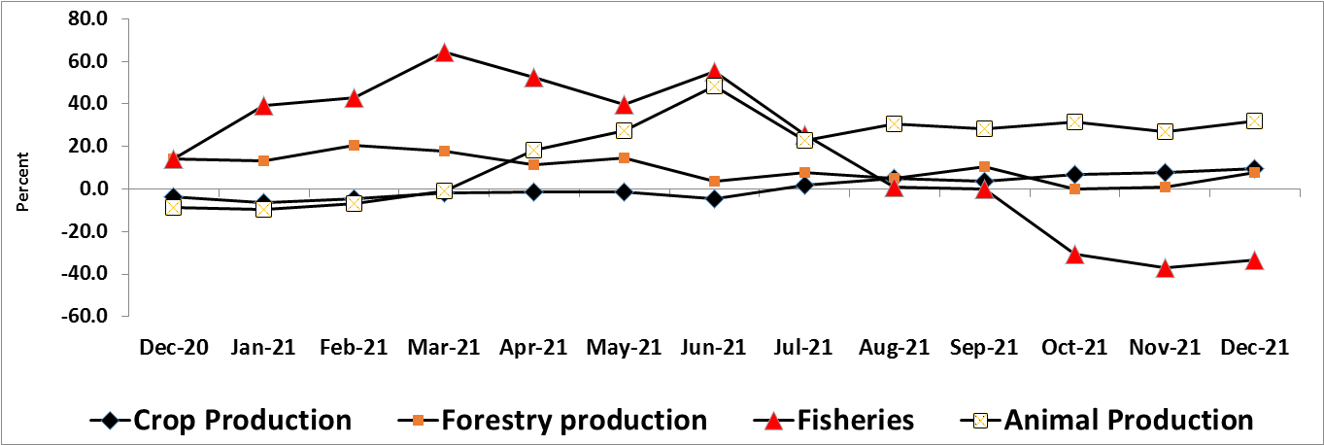
PPI-A Annual Inflation Dec 2020 – Dec 2021 by Division

Slide 19
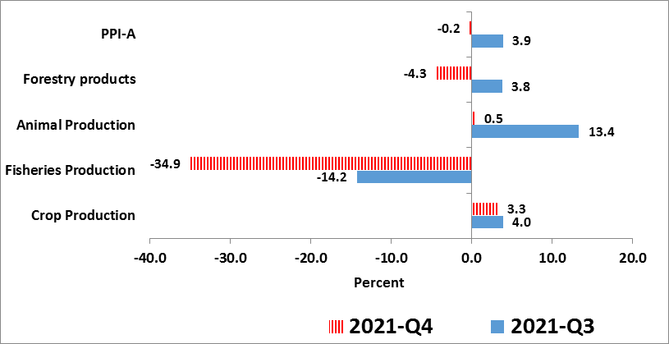
Quarter-on- Quarter Changes in 2021 Q 3 & Q 4
Comparison between Q3 (July-Sept ) and Q4 ( Oct – Dec) 2021.
The prices for agriculture commodities are determined by supply/demand pressures of during the festive season.
Overall there was high demand for crops and animals as expected. So crop prices increased by 3.3% while animal prices increased by 0.5%.
However, between Q3 &Q4, the PPI-A declined by 0.2% mainly caused by reduced prices of fish.

Slide 20
Quarterly Changes in 2021 Q 3 & Q 4-Table 3

Slide 21
Quarterly Changes in 2021 Q 3 & Q 4-Table 3

Slide 22
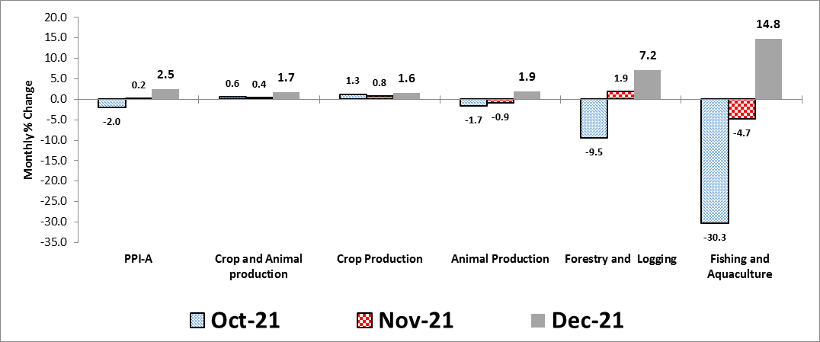
Month-on-Month Inflation Oct - Dec 2021 by Division

Slide 23
Month-on-Month Inflation Oct - Dec 2021 by Division
Table 2

Slide 24
I Thank you

Slide 25
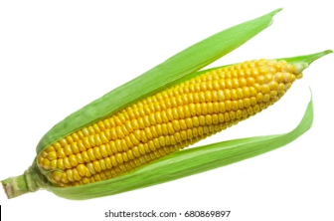
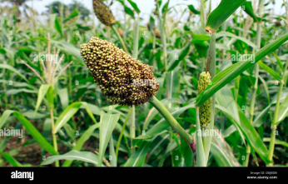
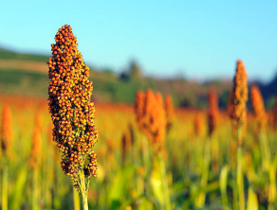
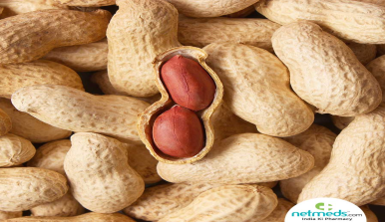
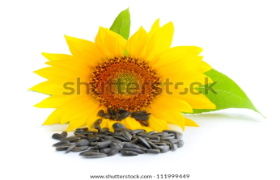
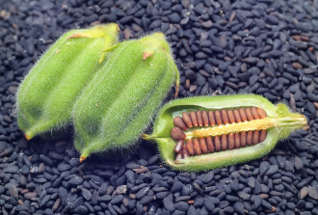
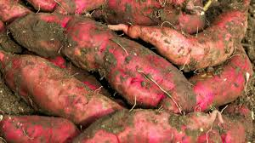
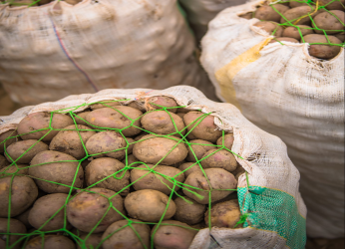
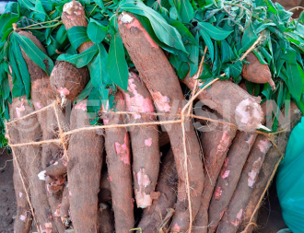
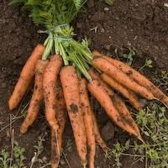
Crop, Animal, Fish Prices in 2021 Q4
Turning points for farm-gate prices
Mar-June 2020 decline – low demand for animals and crop due to covid-19 lock down
Jan-March 2021 rise in crop prices was due to scarcity and planting season.
Jan-March 2021 decline in animal prices was due reduced demand after the December festive season.
Controls on fishing, cost of requirements, local & International demand are pushing up fish prices.
Cereals; Maize, Millet, Sorghum increased by 16.3%
Oil seeds; G.nuts, Sunflower, Sim-sim increased by 8.4%
Root-Tubers; Potatoes, cassava increased by 2.6%

Slide 26
Background
Agriculture is a source of livelihood to majority of Households in Uganda and an effective mechanism for growth of other sectors(NDP)
About 80% of households are engaged in agriculture-Census 2014.
About 47% of Households in urban and 92% in the rural are engaged Agriculture- Census
56% of Households are in pure subsistence farming(unhs)
64.3%(2016/17) to 68.1%(2019/20) of the working population are working in Agriculture (UNHS)
39%(2016/17) to 47%(2019/20) of the working population are in subsistence Agriculture (UNHS)
Accounts for 36% of employment(paid work) in Uganda.
Households with enterprises based in Agriculture increased 6.5% (2016/17) to 7.5% (2019/20)
Due to covid-19, working persons in subsistence Agriculture increased 41% - 52% (UNHS)
Agriculture sector contributed 24.0% to overall GDP at current prices in 2019/20
The sector recorded a growth rate of 4.8% in 2019/20
Commercialization of Agriculture continues to linked farms to the market economy.

