Slide 1


UGANDA BUREAU OF STATISTICS
Greater Kampala Metropolitan Area (GKMA)
Residential Property Price Index:
THIRD QUARTER 2021/22
Juliet Nakayenga
Senior Statistician (Prices)

Slide 2
LAY OUT
1.0 Introduction
2.0 Weights
3.0 Financial Year 2021/22 Results
4.0 Annual Results
5.0 Quarterly Results

Slide 3
Introduction
The results cover Residential Property Price Index (RPPI) for Greater Kampala Metropolitan Area (GKMA), covering Kampala district and urban areas of Wakiso district.
Uganda Bureau of Statistics (UBOS) uses the method of Hedonic pricing approach to compute the RPPI.
Hedonic pricing is a method that identifies price factors. The factors are represented as price determining characteristics that exist and affect both internal and external features of the property.

Slide 4
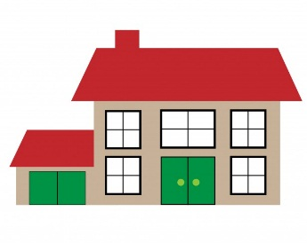
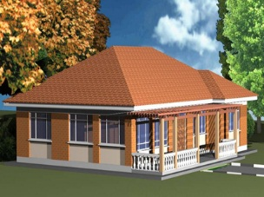
      Weights for different Geographical Areas
Wakiso takes the biggest weight of the stock of houses for sale with in GKMA

Slide 5
Year–on-Year Quarterly Results
The Annual Inflation for residential properties in the GKMA declined to minus 5.8 % for the Q3 FY 2021/2022 compared to minus 4.8 % registered for the Q2 FY 2021/2022.
The decline was due to residential properties in Kampala Central and Makindye area that declined to minus 7.9% for the year ending Q3 2021/2022 compared to 17.4% registered for the year ended Q2 2021/2022.
However, during the same period, the annual inflation of properties in Wakiso areas increased to minus 1.9% for the year ending Q3 2021/2022 compared to minus 20.6% recorded in Q2 2021/2022.

Slide 6
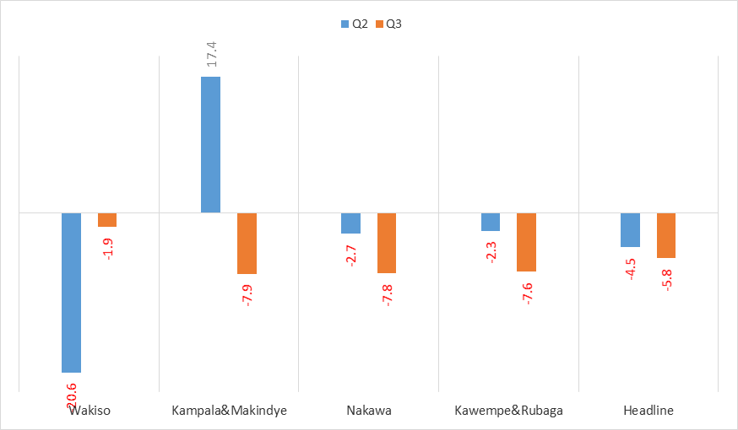
Year – on - Year Quarterly % Changes for GKMA: Q2 2021/2022 and Q3, 2021/2022.

Slide 7
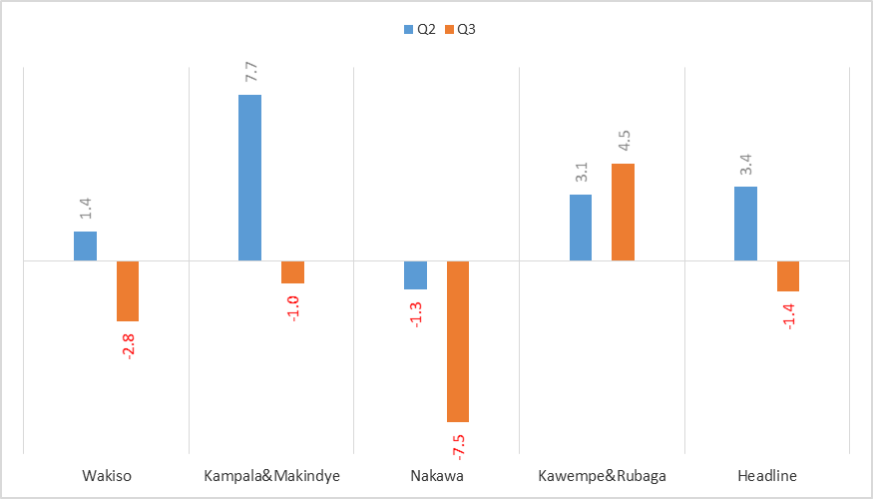
Quarterly Results
The Quarterly inflation for residential properties registered 1.4% drop during the quarter Q3 2021/2022 from the 3.4% rise registered during the quarter Q2 2021/2022.

Slide 8
THANK YOU!
Next release will be on Thursday 30 June 2022

