Slide 1
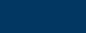
  UGANDA TOURISM SATELLITE ACCOUNTS
Presented by: Aliziki K. Lubega
2023

Slide 2
PRESENTATION OUTLINE
Reconciliation of Tourism Demand and Supply
Tourism Employment
Tourism Collective Consumption
Tourism Gross Fixed capital formation
Non Monetary Tables
Conclusion & Way forward
2023

Slide 3
Data source
Table | Data source | Periodicity | Responsibility
Table 5 production | GDP | Annual | UBOS
Table 6 Reconciliation of Demand & Supply | Table 5 and 4 | Annual | UBOS & MTWA
Table 7 Employment of tourism industries | Manpower Survey Uganda (Mapu) |  | UBOS
Table 8 Tourism gross fixed capital formation of tourism industries and other industries | National Accounts | Annual & Quaterly | UBOS
Table 9 Tourism Collective Consumption | Administrative data sources (MDA reports) | Annual | MTWA, BOU, MoFPED, UBOS
Table 10 Non monetary indicators | Tourism Expenditure survey | Annual | MTWA

Slide 4


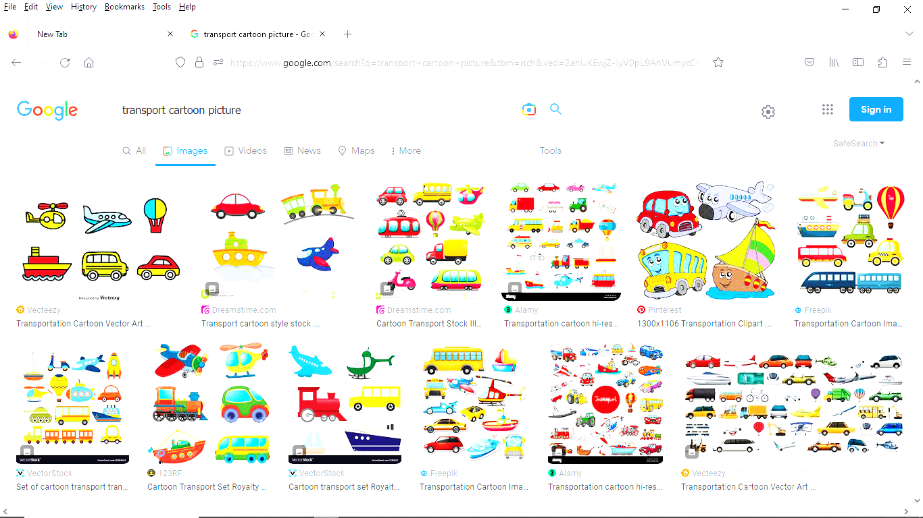




TSA Table 5-Production accounts for Tourism Industries
1. Accommodation services for visitors
2. Food- and beverage-serving services
3. Railway passenger transport services
4. Road passenger transport services
5. Water passenger transport services
6. Air passenger transport services
7. Transport equipment rental services
8. Travel agencies and other reservation services
9. Cultural services
10. Sports and recreational services
11. Country-specific tourism characteristic goods
12. Country-specific tourism characteristic services
Production Accounts contain the output produced by the tourism industries from the TSA;RFM 2008 as listed below.
The table shows the total supply of tourism products in the economy.
The data used is from the compiled and published GDP figures. It provides output and intermediate consumption for tourism and other industries.

Slide 5
TSA Table 5-Production accounts for Tourism Industries
Tourism Output less intermediate consumption (inputs) gives the Gross Value Added (GVA) for each tourism industry.
Gross Value Added for the tourism industries was estimated at UGX 6,233.2 Bn
2023

Slide 6
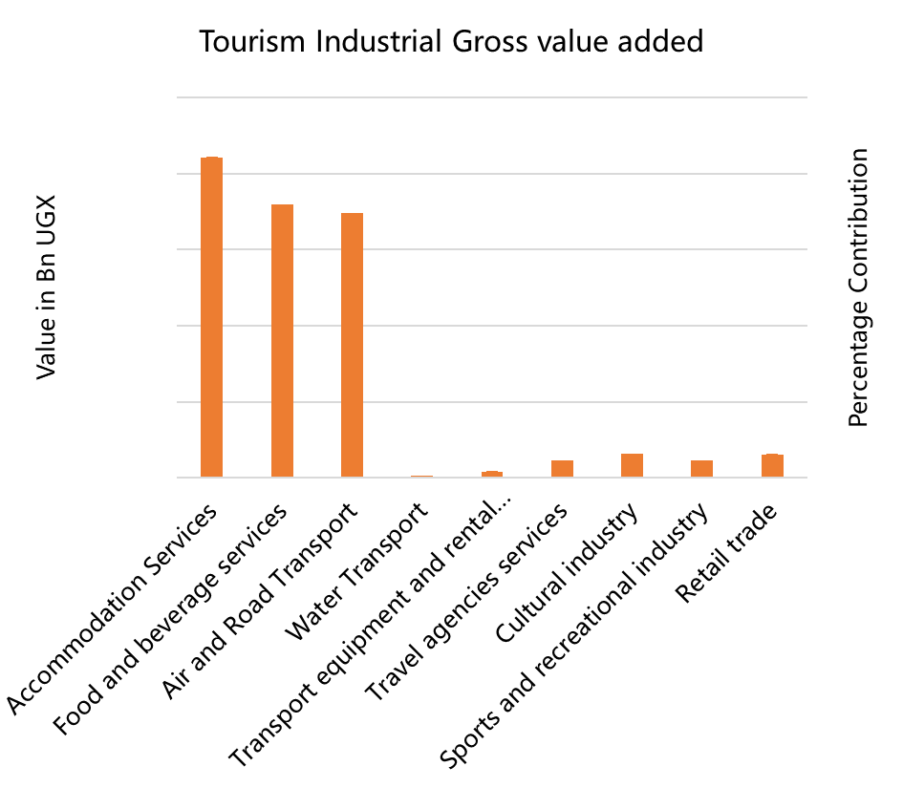
TSA Table 5-Production accounts for Tourism Industries
2023
Tourism Industrial Gross Value Added
Accommodation services - 33.8% (UGX 2.1 Trillion)
Food and beverage services - 28.8% (UGX 1,8 Trillion)
Air & Road Transport - 27.9% (UGX 1.7 Trillion)

Slide 7
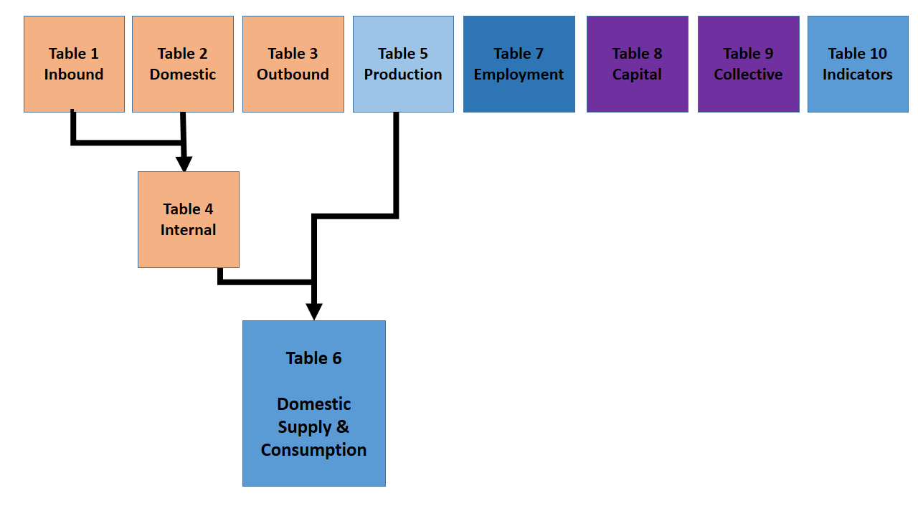
Table 6 Reconciliation of Demand and Supply
2023
This is derived from table 4 and 5.
That is Tourism demand (consumption) and production (supply)
Prepared to compare the Tourism sector contribution with the entire economy.

Slide 8
KEY FINDINGS
2023
Tourism direct contribution to GDP in 2019 is 3.6 percent.
In monetary terms, the Tourism sector was estimated at UGX 5.1 trillion compared to total GDP of UGX 139.9 trillion in 2019
The Value Added in the Tourism industry was estimated at UGX 4.8 trillion in 2019 when adjusted for taxes and subsides on products.
The tourism sector contributed 2.6 percent (UGX 264.2 Bn) to the Taxes on products.
In Billion UGX | Domestic supply (at purchasers' price) | Internal tourism consumption | Tourism percentage share
Gross output | 199,623.1 | 7,712.9 | 3.9
Intermediate Consumption | 69,761.5 | 2,883.9 | 4.1
Gross value added | 129,861.6 | 4,829.0 | 3.7
Taxes on products | 10,057.9 | 264.2 | 2.6
Gross Domestic Product | 139,919.5 | 5,093.2 | 3.6

Slide 9
KEY FINDINGS
2023
Value Added, 2019 in Billion UGX | GVA | %ge Share to Total GDP
GDP at market prices | 139,920 | 100.0
Agriculture, forestry and fishing | 32,979 | 23.6
Cash crops | 2,772 | 2.0
Food crops | 16,231 | 11.6
Livestock | 5,049 | 3.6
Agriculture Support Services | 20 | 0.0
Forestry | 5,587 | 4.0
Fishing | 3,320 | 2.4
Industry | 36,779 | 26.3
Mining & quarrying | 2,310 | 1.7
Manufacturing | 21,656 | 15.5
Electricity | 1,873 | 1.3
Water | 3,111 | 2.2
Construction | 7,829 | 5.6
Services | 60,104 | 43.0
Trade and Repairs | 11,943 | 8.5
Transport and storage | 4,797 | 3.4
Accommodation and Food Service Activities | 3,850 | 2.8
Information and Communication | 2,553 | 1.8
Financial and Insurance Activities | 3,748 | 2.7
Real Estate Activities | 8,863 | 6.3
Professional, Scientific and Technical Activities | 2,911 | 2.1
Administrative and Support Service Activities | 2,556 | 1.8
Public Administration | 3,668 | 2.6
Education | 5,963 | 4.3
Human Health and Social Work Activities | 4,546 | 3.2
Arts, Entertainment and Recreation | 258 | 0.2
Other Service Activities | 3,388 | 2.4
Activities of Households as Employers | 1,059 | 0.8
Taxes on products | 10,058 | 7.2
Tourism Sector is contributes more than most activities in the overall GDP

Slide 10
KEY FINDINGS- Supply to Tourism
Supply to Tourism was estimated at UGX 7.99 Trillion of the total supply of UGX 209.7 Trillion in the economy in 2019, representing 3.8 percent of the total domestic supply.
Cultural industry - 96.0 percent of its output consumed by tourists.
Air and Road Transport industry - 85.1 percent.
Accommodation services - 72.4 percent
2023
Products, in Billion UGX | Domestic supply | Internal tourism consumption | Tourism percentage share
Accommodation services for visitors | 3,161.9 | 2,290.5 | 72.4
Food and beverage services | 3,248.0 | 1,838.6 | 56.6
Air and Road passenger transport services | 2,833.6 | 2,411.5 | 85.1
Water passenger transport services | 196.7 | 14.5 | 7.4
Transport equipment rental services | 82.1 | 42.5 | 51.7
Travel agencies and other reservation services | 269.0 | 159.5 | 59.3
Cultural services | 322.6 | 309.6 | 96.0
Sports and recreational services | 264.4 | 146.3 | 55.3
Other consumption products | 448.7 | 17.2 | 3.8
Other non-consumption products | 198,853.9 | 766.7 | 0.4
Gross Output | 209,680.9 | 7,996.9

Slide 11
KEY FINDINGS-Tourism Value Addition
Tourism Value Addition was estimated UGX 4.8 Trillion of the total Value Added of UGX 129.9 Trillion in 2019, representing 3.7 percent
Accommodation services contributed the most (31.8 percent) to tourism GVA
Air and Road passenger transport services followed with 30.7 percent
Food and beverage services contributed 21.3 percent
Cultural services contributed 3.1 percent
2023
Industries | Total economy GVA | Tourism share | Percentage contribution to total GVA
Accommodation services for visitors | 2,105.6 | 1,533.8 | 31.8
Food and beverage services | 1,797.8 | 1,030.2 | 21.3
Air and Road passenger transport services | 1,741.0 | 1,481.7 | 30.7
Water passenger transport services | 14.6 | 8.6 | 0.2
Transport equipment rental services | 40.6 | 23.5 | 0.5
Travel agencies and other reservation services | 111.1 | 65.7 | 1.4
Cultural services | 155.4 | 150.9 | 3.1
Sports and recreational services | 113.2 | 62.6 | 1.3
Other consumption products | 153.9 | 9.7 | 0.2
Other non tourism products | 123,628.4 | 462.3 | 9.6
Total GVA | 129,861.6 | 4,829.0 | 100.0

Slide 12
KEY FINDINGS on Macroeconomic Indicators
2023
According to the findings, Tourism sector has a positive performance on all macro economic indicators
Inbound tourism expenditure alone contributes 3.3 percent to GDP and its almost 3 times outbound tourism expenditure
Macroeconomic indicators related to international tourism | In Million UGX | In Million UGX | Percent
Inbound tourism expenditure over GDP | 4,580,399 | 139,919,538 | 3.3
Outbound tourism expenditure over GDP | 1,666,281 | 139,919,538 | 1.2
Tourism balance (inbound minus outbound tourism expenditure) over GDP | 2,914,119 | 139,919,538 | 2.1
Tourism openness (inbound plus outbound tourism expenditure) over GDP | 6,246,680 | 139,919,538 | 4.5
Tourism coverage (inbound over outbound tourism expenditure) | 4,580,399 | 1,666,281 | 274.9
Inbound tourism expenditure over exports of goods | 4,580,399 | 15,170,202 | 30.2
Inbound tourism expenditure over exports of services | 4,580,399 | 7,689,901 | 59.6
Inbound tourism expenditure over exports of goods and services | 4,580,399 | 22,860,103 | 20.0
Inbound tourism expenditure over current account credits | 4,580,399 | 30,602,800 | 15.0
Outbound tourism expenditure over imports of goods | 1,666,281 | 25,373,064 | 6.6
Outbound tourism expenditure over imports of services | 1,666,281 | 10,907,721 | 15.3
Outbound tourism expenditure over imports of goods and services | 1,666,281 | 36,280,785 | 4.6
Outbound tourism expenditure over current account debits | 1,666,281 | 39,891,212 | 4.2

Slide 13
KEY FINDINGS -Tourism Employment
Employment
Total 10.6 Million persons | Tourism Industry 1.6 Million persons
Employment in tourism refers to the number of people employed in the tourism sector.
Tourism covers a diverse range of activities and provides a substantial contribution to Uganda’s economy, making it a major employer of Ugandan workers
The Tourism Industry in 2019 provided Employment for 1,559,147 workers equivalent to 14.7% of total employment

Slide 14
KEY FINDINGS -Tourism Employment
2023
The top contributors to Employment in Tourism are Food, Transport and the cultural Industry.
8 in every 10 workers employed in Tourism are in the Food and Beverage Serving industry

Slide 15
KEY FINDINGS -Tourism Employment
Number of persons directly employed in tourism industries by industry type and status in employment
People working in tourism are more likely to be self-employed.
In 2019, tourism provided employment to 819,574 self-employed workers (52.6%).
The food services industry consists of cafes, restaurants and takeaways, clubs, pubs & bars which are the main employers of tourism workers. The industry provided employment to 1,295,281 persons in this industry in 2019.
Other leading employers were
  Passenger Transport –120,913 workers
  Cultural Industry-80,869 workers
  Accommodation-58,716 workers
  Travel agencies and other reservation industry-3,368 workers
Two thirds of tourism jobs are in food and beverage serving services
Tourism industries | Status in employment |  |  | %age share
 | Employees | Self-employed | Total employment
Accommodation services for visitors | 40,784 | 17,932 | 58,716 | 3.8
Food- and beverage-serving industry | 603,580 | 691,701 | 1,295,281 | 83.1
Road, Air, Rail and Water passenger transport | 41,077 | 79,835 | 120,913 | 7.8
Travel agencies and other reservation industry | 2,731 | 638 | 3,368 | 0.2
Cultural industry | 51,401 | 29,468 | 80,869 | 5.2
Total (tourism industries) | 739,573 | 819,574 | 1,559,147 | 100
National (all industries) | 4,663,277 | 5,972,592 | 10,635,869
% Share of tourism to national | 15.9 | 13.7 | 14.7

Slide 16
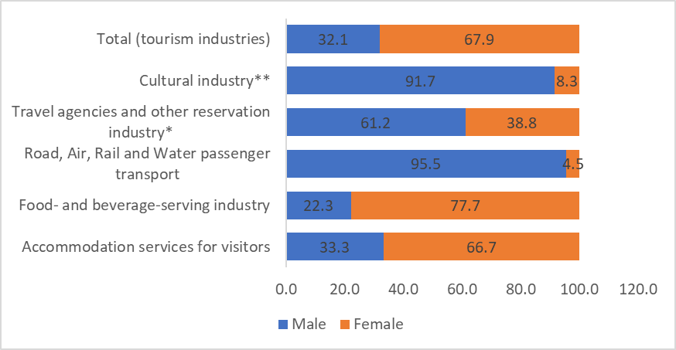
KEY FINDINGS -Tourism Employment by Gender
2023
In 2019 1,059,300 females were employed in the Tourism translating into 68 %
However, male are dominant in all Tourism Industries except Food serving and Accommodation services industry.
Distribution of direct tourism Employment by sex and industry type

Slide 17
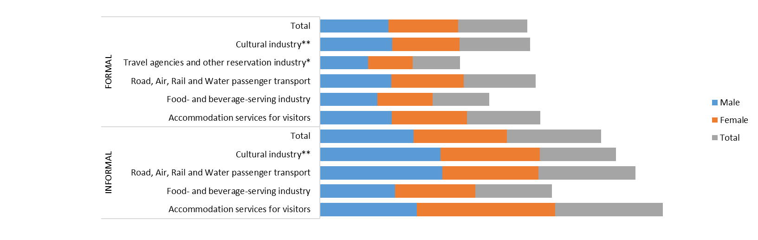
KEY FINDINGS -Tourism Employment by Gender
Average usual hours of work spent by persons employed in tourism industries per week by sex and industry of employment
2023
On average, persons employed directly in the informal tourism industry spent 57 hours at work compared to those in the formal industry (42 hours) on a weekly basis.

Slide 18
KEY FINDINGS -Monthly Earnings
2023
On average the monthly pay for employees in the Tourism industry was estimated at UGX 145,000 (net) and UGX. 179,000 (gross).
Monthly Earnings for Paid Employees in the formal industry by sex and type of earning, (UGX ‘000)
Tourism industry | Gross earnings |  |  | Net earnings
 | Male | Female | Total | Male | Female | Total
Accommodation services for visitors | 182 | 124 | 146 | 160 | 116 | 146
Food- and beverage-serving industry | 115 | 104 | 115 | 114 | 98 | 104
Road, Air, Rail and Water passenger transport | 1,161 | 1,109 | 1,154 | 849 | 669 | 838
Travel agencies and other reservation industry | 706 | 118 | 471 | 412 | 118 | 412
Cultural industry | 397 | 278 | 318 | 318 | 254 | 290
Total (tourism industries) | 215 | 143 | 179 | 186 | 143 | 145

Slide 19
KEY FINDINGS – Tourism Investment
2023
Uganda’s total Investment in 2019 is estimated at UGX 33.8 trillion, of which 6.4 trillion was from tourism investment accounting for 19.0% of total investment in this period
Products | Tourism GFCF | Other GFCF | Total GFCF | Tourism ratio (percent )
 | a | b | c=a+b | d=a/c
Accommodation for visitors | 3,172 | 5,708 | 8,880 | 35.7
Other non-residential buildings and structures proper to tourism industries | 1,094 | 11,354 | 12,448 | 8.8
Passenger transport equipment for tourism purposes | 1,015 | 1,549 | 2,564 | 39.6
Other machinery and equipment specialized for the production of tourism characteristic products | 1,163 | 6,155 | 7,318 | 15.9
Investment by the tourism industries in other non-tourism- specific produced assets | 24,766 | 2,637 | 27,403
Total | 6,445 | 27,403 | 33,848 | 19.0
Tourism-specific fixed assets - Government | 1,507 | 6,410 | 7,917

Slide 20
KEY FINDINGS – Tourism Investment
The total investment in Accommodation is estimated at UGX8.9 trillion of which UGX3.2 trillion is estimated for Tourism specific assets for Accommodation – that is 35.7%
Passenger transport equipment for tourism purposes was estimated at UGX 1 trillion compared to the total investment in passenger transport of UGX 2.6 trillion - 39.6 %.
2023
Products | Tourism GFCF | Other GFCF | Total GFCF | Tourism ratio (percent)
 | a | b | c=a+b | d=a/c
Accommodation for visitors | 3,172 | 5,708 | 8,880 | 35.7
Other non-residential buildings and structures proper to tourism industries | 1,094 | 11,354 | 12,448 | 8.8
Passenger transport equipment for tourism purposes | 1,015 | 1,549 | 2,564 | 39.6
Other machinery and equipment specialized for the production of tourism characteristic products | 1,163 | 6,155 | 7,318 | 15.9
Investment by the tourism industries in other non-tourism- specific produced assets | 24,766 | 2,637 | 27,403
Total | 6,445 | 27,403 | 33,848 | 19.0
Tourism-specific fixed assets - Government | 1,507 | 6,410 | 7,917

Slide 21
KEY FINDINGS – Tourism Collective Consumption
2023
The total collective consumption largely related to tourism was estimated at UGX 903.34 Billion representing 2.41 % of the total collective consumption in Uganda.
The collective consumption from expenditure by the Central government is UGX 903.11 Billion while at local government level is UGX 220 million only.
The highest expenditure for tourism related consumption is on Public administrative services, contributing 78.1% of the total tourism collective consumption.
The consumption of Tourism promotion services constituted 20.83 percent (UGX 188.16 Billion)

Slide 22
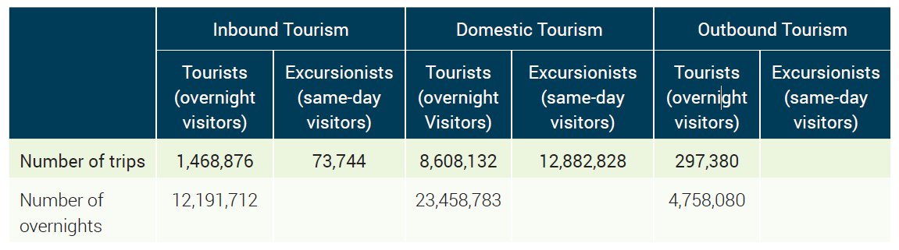
KEY FINDINGS – Non-Monetary Indicators
2023
Number of trips and overnights by forms of tourism and classes of visitors, 2019
Majority of the trips and overnights were in domestic tourism

Slide 23
KEY FINDINGS – Non-Monetary Indicators Cont.
2023
Close to 580,000 inbound visitors (35.8 %) travelled by air through scheduled flights, the rest of inbound visitors (64.2 %) were reported to have used Road as their mode of travel.
Uganda has a total of 16,465 accommodation establishments.
These include Hotels, Resort hotels, Motels, Motor hotels, Guesthouses, Bed and breakfast units, Time-share units, Chalets, housekeeping cottages, cabins, among others.
Inbound tourism: Number of arrivals and overnights by modes of transport, 2019
modes of transport | Number of Arrivals | Number of Overnights
Air Transport | 579,957 | 4,583,548
Scheduled flights | 579,957 | 4,583,548
Land Transport | 962,663 | 7,608,165
Total | 1,542,620 | 12,191,712
Number of establishments and capacity by types of accommodation
 | Short-term Accommodation Activities
Number of establishments | 16,465
Capacity (rooms) | 255,203
Capacity (beds) | 270,252
Capacity utilization (rooms) | 51.90 percent
Capacity utilization (beds) | 45.80 percent

Slide 24
KEY FINDINGS – Non-Monetary Indicators Cont.
Number of establishments in tourism industries classified according to average number of jobs (2019)
2023
A total of 615,856 Tourism establishments were reported in 2019 with the majority employing between an average of between 1 to 4 workers, (85.7 % of the total number of Establishments). 10 % of the establishments (61,425) employed between 5 to 9 workers while less than 5 % offered more than 10 jobs in 2019.

Slide 25
Summary
Direct Tourism Contribution to GDP was estimated at 3.6 %
The tourism sector contributed 2.6 % to the Taxes on products.
2 in 10 Ugandans are employed in Tourism
Tourism is an industry with high self employed and female employment
Tourism is an industry with a large informal sector
Two thirds of tourism employment is in food and beverage serving services
19.0 % of the total investment in the economy (GFCF),was for tourism investment
The total collective consumption largely related to tourism was 2.41 % of the total collective consumption in Uganda.

Slide 26
Way forward
Publish TSA on a biennially using the updated data for 2021
Engage with stakeholders to provide the required data on a regular basis
Lobby for funds to undertake the necessary surveys
2023

Slide 28

2023
Thank You for Listening

