Slide 1
OVERVIEW
CHIARA BRUNELLI
Statistician
Acting Programme Manager of Initiative’s Data Production Component
Food and Agriculture Organization of the United Nations (FAO)
AAS 2019 DISSEMINATION WORKSHOP,
KAMPALA, 15 NOVEMBER 2021

Slide 2

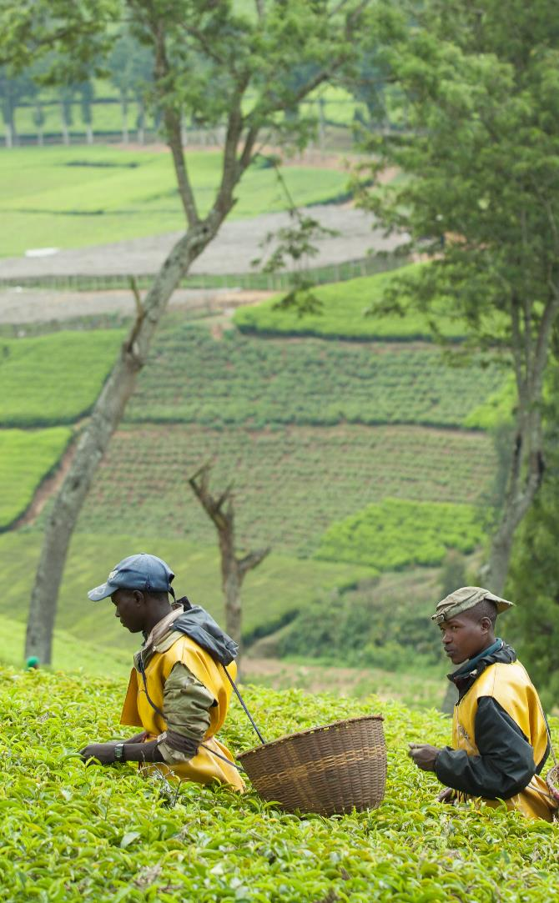
50x2030 INITIATIVE:
GOAL
Build partnerships to close the data gap in agricultural statistics
Improve country capacity to produce, analyze, interpret and apply data to policies and decisions in agricultural sector
Provide infrastructure to build evidence-informed policies for rural development and food security

Slide 3
50x2030 INITIATIVE: OBJECTIVES
OBJ 1: BUILD STRONG AGRICULTURE DATA SYSTEMS
Empower 50 L/LMICS to build sustainable, strong national data systems
Capacitate countries to produce, disseminate and use timely, high quality agricultural and rural data
Develop survey programs using sound, cost-effective methods and tools
OBJ 2: MONITOR AND REPORT ON SDG 2 AND GENDER INDICATORS
Produce data to monitor national indicators
Monitor SDG 2 indicators on Zero Hunger (i.e., 2.3.1, 2.3.2, and 2.4.1), and Gender (i.e., 5.a.1)
Generate other data/indicators to report on regional commitments (e.g., CAADP)
OBJ 3: PRODUCE DATA FOR POLICY, DEVELOPMENT PROGRAMS, INVESTMENTS
Generate data needed for policy-making and monitoring agricultural development programs
Produce relevant data for investment decisions
Integrate economic, social, technical and environmental themes and rural development indicators in surveys to analyze drivers of productivity

Slide 4
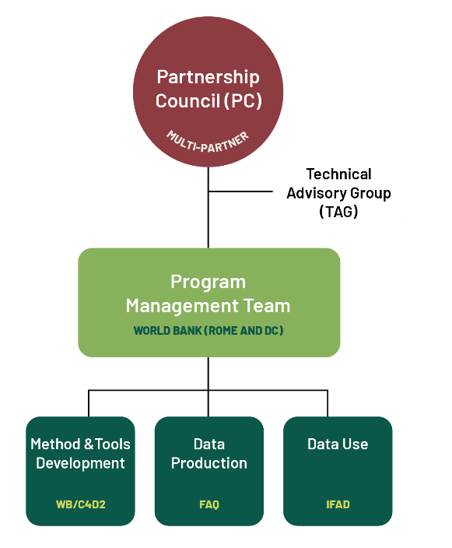


50x2030 INITIATIVE: PARTNERSHIP
POWERFUL ALLIANCE
GOVERNANCE & ORGANIZATIONAL STRUCTURE

Slide 5
50x2030 INITIATIVE: COMPONENTS
DATA PRODUCTION (FAO)
Support countries to produce and disseminate better and more timely agricultural data through technical assistance and financial support in establishing an integrated survey program
Main Outputs:
  Agricultural surveys conducted annually
  Data analysed, results shared and documented datasets disseminated
METHODS & TOOLS (WB)
Conduct research and develop tools to improve measurement and understanding of agricultural productivity
Main Outputs:
  More efficient tools adopted in national agricultural survey programmes
DATA USE (IFAD)
Increase use of survey data to inform investments and policies at national, regional and global levels
Main Outputs:
  Data ecosystem mapping
  Capacity building/training
  Improved communication strategies and networks

Slide 6
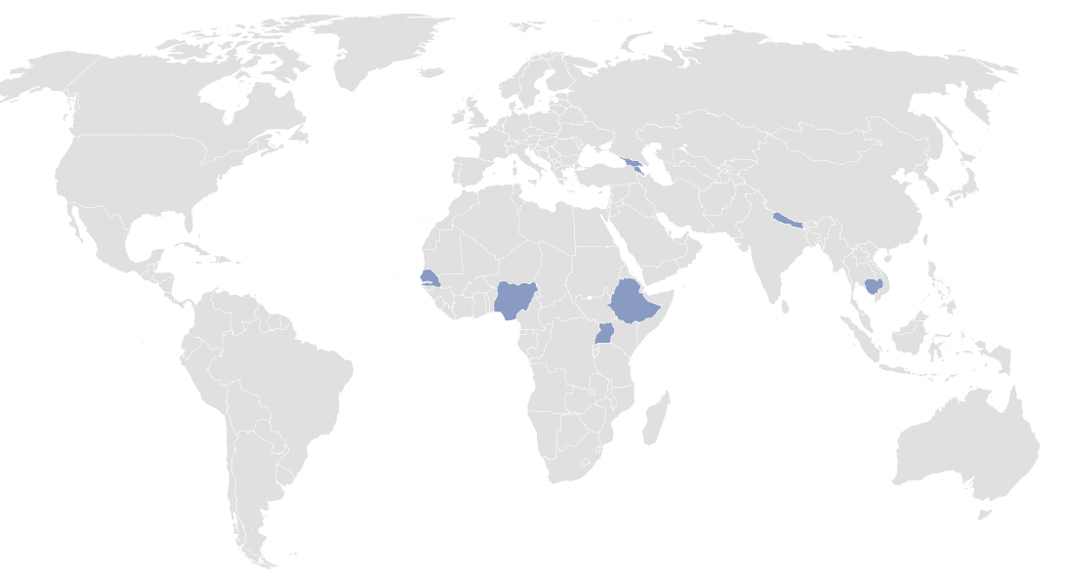
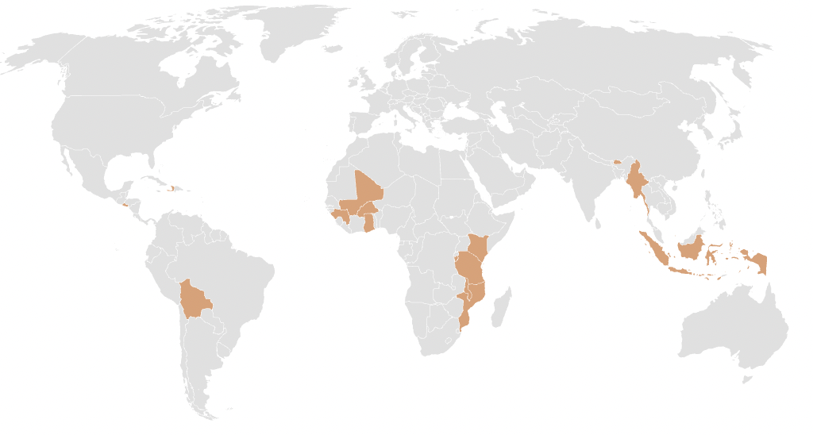
50x2030 INITIATIVE: WHERE WE WORK
8 on-going countries
+ 16 countries on-boarding in 2022

Slide 7
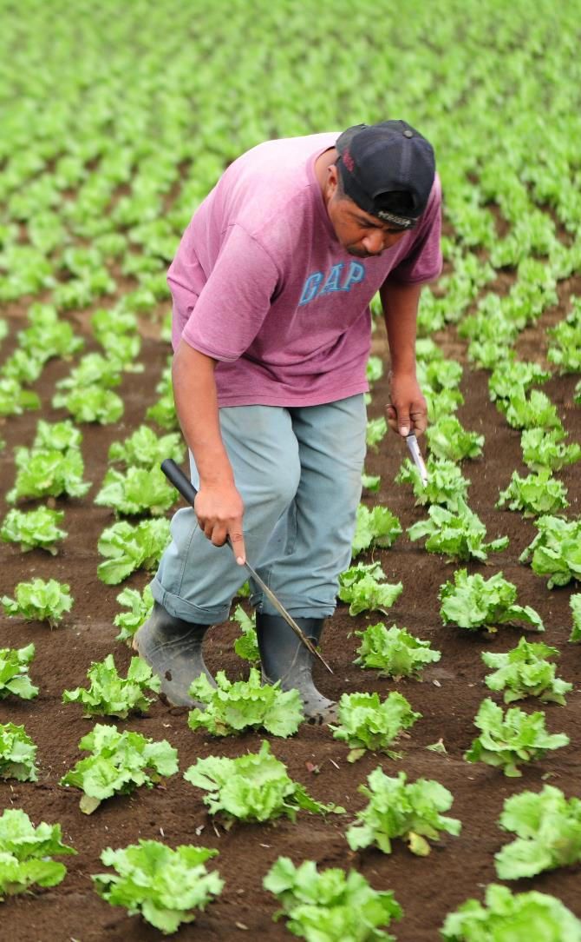
PARTNER COUNTRY ENGAGEMENT
Partner Countries are expected to:
Show High Level Commitment
Political commitment during entire implementation period of the Initiative (5-8 years) and ensure a progressive technical and financial take over of the survey programme
Ensure Effective Governance
Country should endeavour to strengthen governance and visibility of agriculture sector in the National Statistical System
Undertake Efficient Planning
Improved long-term agriculture strategic planning in the country is necessary
Provide Adequate Human Resources
Countries should dedicate qualified team for implementation; 50x2030 may support the establishment of mechanisms for setting up a central pool of agricultural statisticians
7

Slide 8
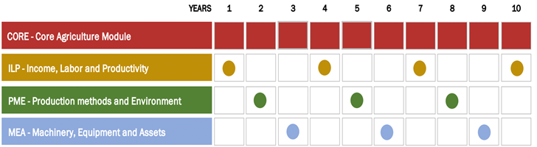
METHODOLOGY
INTEGRATED AGRICULTURAL
AND RURAL SURVEY
PROGRAM
AGRICULTURAL
SURVEY
PROGRAM
HOUSEHOLDS AND NON–HOUSEHOLD HOLDINGS
HOUSEHOLDS AND NON–HOUSEHOLD HOLDINGS
RURAL HOUSEHOLDS
An annual core production survey complemented by a set of specialized tools in rotation
Integrating household survey tool and broadening target population to incorporate a sample of rural, non-agricultural households into the system every three years

Slide 9
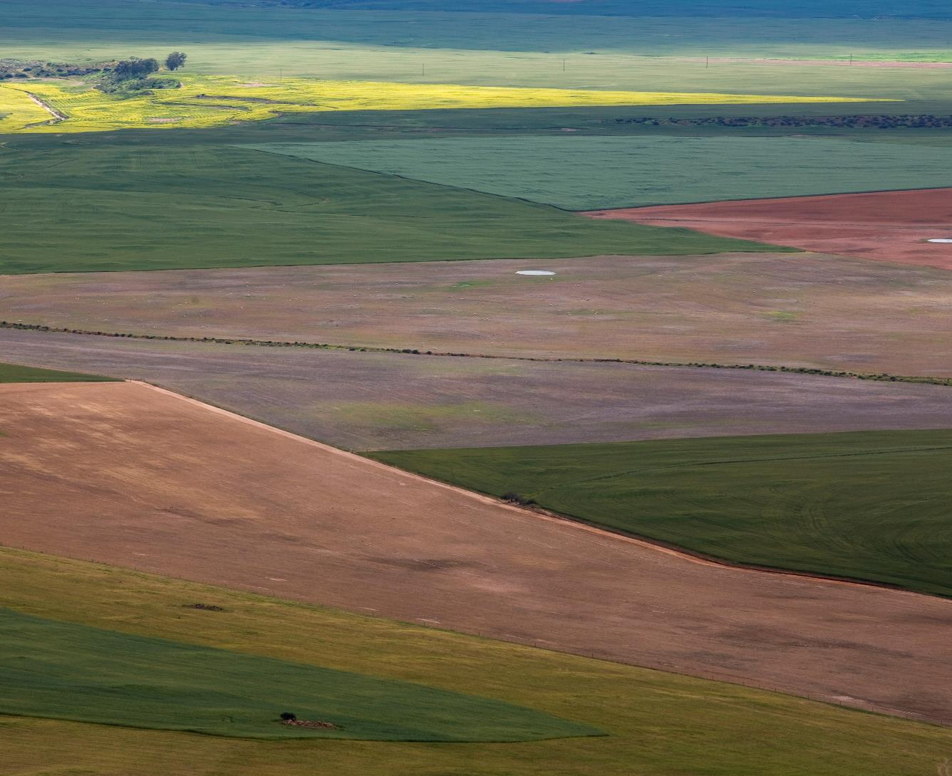
INITIATIVE’S WORK IN UGANDA
9

Slide 10
2019
2020
2021
2022
2023
2024
INITIATIVE’S WORK IN UGANDA
ESTABLISHMENT OF THE UHIS
FAO and WB jointly provide technical support for the design of the UHIS (sampling, questionnaires, field work planning, etc.)
Integration of methodological experiments in the UHIS 2021/22 (seed variety, maize crop cutting)
Survey co-funding
UHIS 2021/22 launched

Slide 11
INITIATIVE’S WORK IN UGANDA
2019
2020
2021
2022
2023
2024
UHIS REFINEMENT AND FINDINGS
Continue providing technical and financial support for two more rounds of the UHIS (2022/23 and 2023/24)
Support data collection, data processing and release of findings and micro-data
Continue integrating methodological validations

Slide 12
INITIATIVE’S WORK IN UGANDA
2019
2020
2021
2022
2023
2024
IMPROVED USE OF THE DATA
Work closely with MAAIF to mainstream agricultural statistics in the design and monitoring of investment plans, policies and programmes
Monitor National Standard Indicators, CAADP and SDG Goal 2 and Goal 5

Slide 13



        QUESTIONS? Chiara.brunelli@fao.org
        info@50x2030.org
            VISIT 50x2030.ORG

