Slide 1
UGANDA BUREAU OF STATISTICS
DISSEMINATION OF THE SECOND EDITION OF THE NATIONAL INDICATOR (NSI) FRAMEWORK – LEVEL I & II
CONFERENCE HALL STATISTICS HOUSE
17th November 2023
Suuna Luutu
Ag.PST/Strategic Planning
Uganda Bureau of Statistics

Slide 2
Presentation Outline
Introduction
The NSI Framework
  Importance of the NSI
  Structure of the NSI Framework
  Conceptual framework for the NSI
Chain of results and examples of corresponding indicators
Process of updating the NSI Framework
Status of the NSI framework by levels
Progress on NSI level III by programmes
Challenges encountered in updating the NSI
Mitigation measures
Next steps

Slide 3
Introduction
The Government of Uganda is committed to fulfillment of the requirements of different International, Continental, Regional and national development frameworks that include:
    Agenda 2030 for Sustainable Development (SDGs)
    Africa Agenda 2063
    EAC Vision 2050
    Uganda Vision 2040
    Third National Development Plan (NDP III)
    Other Conventions, Treaties and Protocols that the Government of Uganda has ratified
To facilitate implementation, monitoring, and reporting on the development frameworks, UBOS in collaboration with MoFPED, OPM, and NPA developed the maiden National Indicators Framework (NSI) to consolidate national statistical demands on the National Statistical System (NSS).

Slide 4
The NSI Framework
The NSI is a core set of indicators that guides prioritization of statistical production in the NSS
It is a framework that guides tracking progress towards achieving national, regional, continental and global development agendas using a hierarchy of results approach.
Recommendations of the evaluations of the first NDP I and PNSD I revealed inconsistences, incomparability and gaps in the data and indicators produced and submitted by MDAs to the oversight agencies.
The evaluations further underlined the need to define a national set of indicators to address the challenge and facilitate evidence-based planning, budgeting, resource allocation and performance measurement for various government programmes.

Slide 5
Importance of the NSI
Statistical planning framework for the NSS
Facilitates alignment of statistical programmes to development agenda
Guides a holistic, harmonised and well-coordinated process for producing data and statistics for international, national and Institutional reporting.
Reduces reporting fatigue to oversight institutions, development partners and international agencies.
Minimises duplication of efforts in the production and management of statistics in the NSS.

Slide 6
The Structure of the NSI Framework
The NSI Framework is hierarchical and has 4 levels;
  NSI Level I: Presents key indicators that track monitoring of the country’s graduation from LDC to Medium-Income status. These indicators are defined by the United Nations Department for Economic and Social Affairs.
  NSI Level II: presents indicators that facilitate tracking progress towards realization of the NDP III Goals, Objectives and Key Result Areas.
  Level III: presents indicators that measure progress towards realization of the NDP III programme objectives and outcomes. It covers the 20 NDP III programs.
  Level IV: Presents indicators that track implementation of the Programme Implementation Action Plans (PIAPs) in MDAs.
The SDGs, Africa Agenda 2063, EAC 2030 and Uganda Vision 2040 are all integrated at all Levels where applicable.
Notes:
Income Criterion (IC), based on a three year average estimate of Gross National Income (GNI) per capita for the period 2011-2013 using the World Bank Atlas method (under $1,035 for inclusion, above $1,242 for graduation based on where countries are by the 2015 triennial review.
Human Assets Index (HAI), based on indicators of: (a) nutrition: percentage of population undernourished; (b) health: mortality rate for children aged five years or under; (c) education: the gross secondary school enrolment ratio; and (d) adult literacy rate.
Economic Vulnerability Index (EVI), based on indicators of: (a) population size; (b) remoteness; (c) merchandise export concentration; (d) share of agriculture, forestry and fisheries; (e) share of population in low elevated coastal zones; (f) instability of exports; (g) victims of natural disasters; and (h) instability of agricultural production
Goal: Increased household incomes and improved Quality of life

Slide 7
Conceptual framework for the NSI
Vision
Vivid perception, conception, or anticipation of what a country wants to be or wants to stand for and achieve
Indicator
The measure of the state, level, or conditions of the variables of interest
Target
This is a specific planned level of result to be achieved within a specific timeframe with a given level of resources.
Goal
A long-term objective that relates to national development objectives, to which a programme/project can contribute
Objectives
A specific statement of the desired results or accomplishments of the programme or project
Outcome
The intended or achieved medium-term results and effects of a programmer's outputs, usually involving the collective effort of partners
Activity
The specific actions that an organization or a project undertakes to achieve its objectives.
.
Outputs
The tangible products or services that result from the activities undertaken
.
Intermediate Outcome
The short-term and intermediate results or Interim outcomes that lead to the ultimate outcome of an action or a process
Inputs
The financial, human, material, technological and information resource used to implement a project or programme.
.

Slide 8
Chain of results and examples of corresponding indicators
Globally
Zero Poverty
A Transformed Ugandan Society from a Peasant to a Modern and Prosperous Country within 30 years
Vision
Per capita income of USD 9,500 by 2040
Level I & II
Proportion of population below the national poverty line
GDP Per Capita (US$), Current Prices
Life expectancy at birth (years)
NDP III Goal
To Increase Average Household Incomes and Improve the Quality of Life of Ugandans
Enhance value addition in key growth opportunities.
Enhance the productivity and social wellbeing of the population
Average household Income (000' UGX)
US$ Labour Productivity Per Worker – Agriculture
NDP III Objectives
Level III
Increased agricultural production and productivity
Volumes/value of priority agricultural commodities
Outcome
Proportion of farmers adopting improved agricultural technologies
Proportion of farming households accessing improved breed varieties
Increased adoption of Agricultural research technologies
Intermediate Outcome
Animal breeding stock multiplied and distributed to farmers country wide for cattle, poultry, goats, pigs, fish.
Number of regional community breeding satellite centers established and maintained.
Number of poultry varieties developed, multiplied, and promoted.
Number of tropicalized superior breeding stock introduced
Outputs
Level IV
Activity
Undertake agricultural research and technology development

Slide 9
Process of updating the NSI Framework
Review and alignment of indicator matrices to the current data requirements
Profiling potential data sources based on computation methodologies
Institutional visits to the MDAs & consultative meetings to update the NSI
Data mining and further analysis of existing data to produce the indcators
Reviewing provisional data series for accuracy and consistency

Slide 10
Process …
Update indicator matrix with data series and metadata
Documentation of recommendations on indicators whose data is not currently reported
Quality Assurance of the NSIs for approval and dissemination
Printing and dissemination

Slide 11
PROGRESS

Slide 12
Status of the NSI framework by levels
NSI LEVEL | No of indicators | Proportion of Indicators with data
Level I | 51 | 100%
Level II | 140 | 100%
Level III | 812 | 41%
Level IV | 2715 | 52%
This shows major gaps in the level III and IV, which compares well with the NDP III Mid-Term Report

Slide 13
Progress
Of the 201 SDG indicators applicable to Uganda, data series are available for only 121
    14 indicators are under review and validation
    Of the 81 Africa Agenda 2063 Indicators, 55 have up-to-date data series
    Four indicators are under review and validation

Slide 14
Progress on NSI level III by programmes

Slide 15
Challenges encountered in updating the NSI
Limited ownership of the indicators by some MDAs
Lack of methodology on some indicators
Limited funds for statistics in the MDAs workplans & budgets.
Limited internal coordination within MDAs and weak data sharing arrangements
Weak Administrative data systems (Non-responsive and/or inflexible data collection systems and sources).
Inadequate conceptualization and use of new data sources like the big data, and Citizen Generated data

Slide 16
Mitigation measures
UBOS and the MDAs should pay keen interest in the process of developing the NDP IV and corresponding indicator frameworks.
UBOS should continue supporting MDAs in compilation of data and metadata for the indicators
MDAs should mainstream statistics in their budgets and work plans
Revitalise the Statistics Cadre in MDAS
UBOS should support review of tools and automation of data systems in MDAs
MDAs should enhance statistical capacity building in MDAs, HLGs and CSOs

Slide 17
Next steps
Continue with MDA engagements to finalise NSI level III & IV
Upload the NSI into the website and ODPs for online accessibility
Update the NSI with new data series
Integrate comments arising from this dissemination meeting
Collective engagement in the NDP IV processes

Slide 18

Thank You
Merci,

Slide 19


Slide 20

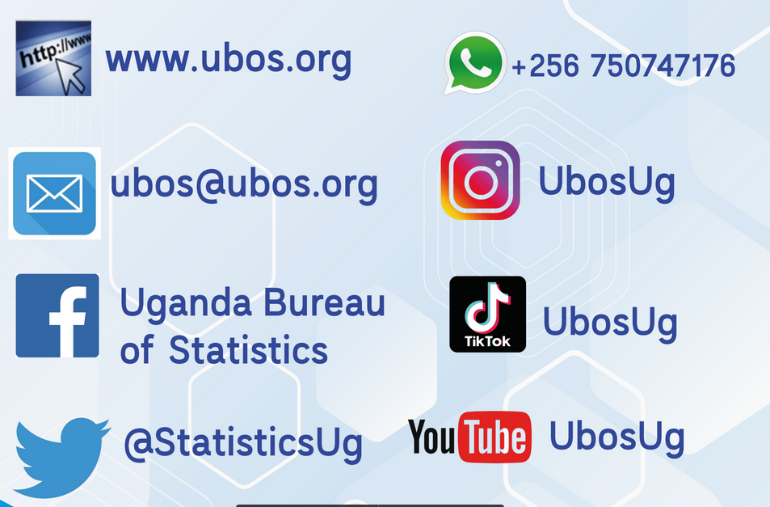
FOLLOW UBOS

Slide 21


