Slide 1


Uganda Bureau of Statistics
Annual Agricultural Survey 2019
Key Findings
Ronald Ssombwe
Principal Statistician
Agriculture and Environment Statistics

Slide 2
Uganda Bureau of Statistics
Overview of the AAS

Slide 3
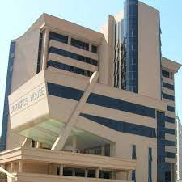
Introduction
The Bureau.
The Uganda Bureau of Statistics (UBOS) is a semi-autonomous body created by the Uganda Bureau of Statistics Act No. 12, 1998.
UBOS is the principal data collection, processing , analyzing and dissemination agency in the National Statistical System(NSS).
Our Mission.
To coordinate the NSS and provide quality statistics and statistical services that support development programs.
UBOS Strategic goals.
a. Strengthened development and production of quality statistics.
b. Enhanced coordination, cooperation and Partnerships in statistical
production and management.
c. Increased use of statistics for development results.

Slide 4
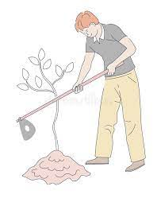
Background
Agriculture is a source of livelihood to the majority of Households in Uganda and an effective mechanism for growth of other sectors(NDP)
About 80% of households are engaged in agriculture-Census 2014.
About 47% of Households in urban and 92% in the rural are engaged Agriculture
About 39% of the working population are subsistence farmers
Agriculture sector contributed 24.0% to overall GDP at current prices in 2019/20
The sector recorded a growth rate of 4.8% in 2019/20
Accounts for 36% of employment in Uganda.
The focus of Vision 2040 is a transformed Ugandan society from a Peasant to a modern and prosperous country within 30 years.

Slide 5



Introduction
The Annual Agricultural Survey(AAS)
Starting in 2017, the AAS is conducted under the mandate of UBOS with collaboration of the Ministry of Agriculture Animal Industry and Fisheries(MAAIF) and support from the UN Food and Agricultural Organisation(FAO).
Overall objective
To provide high quality agricultural data on priority core macro and micro development indicators on the performance of Agriculture Sector in inter-censual periods. Indicators on crop, livestock and environment interaction inform various development frameworks for better policy making.
Thus, the AAS was established to provide key agricultural sector indicators to monitor progress on the NDP and assess the impact of governmental programs.

Slide 6
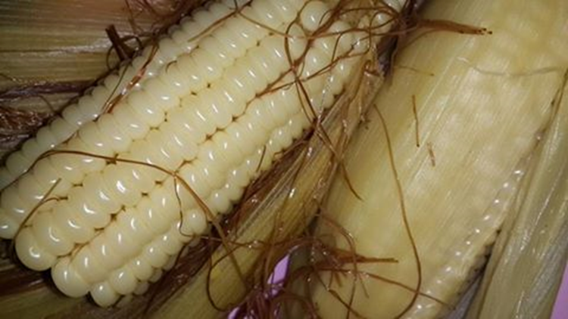
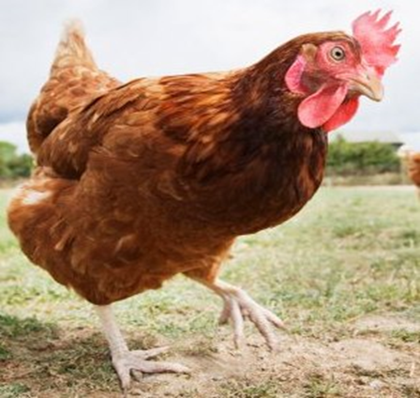
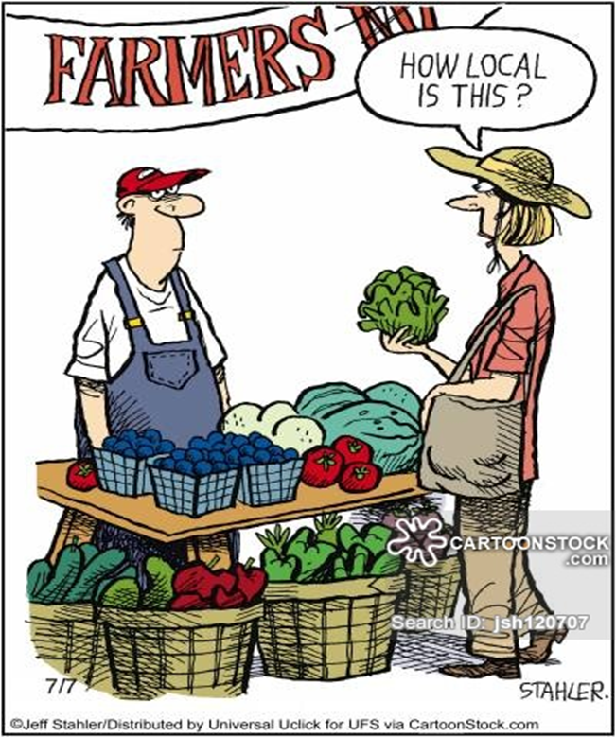
Introduction
Specific objectives
To provide data and information on:
Agricultural production, agricultural land area, prices of agricultural outputs and inputs, market information, farm income, food security, gender and environment;
adoption of agricultural production practices in different agro ecological zones in Uganda and;
adoption and use agricultural production technologies.
G

Slide 7
Geographical Scope and Coverage
All districts of Uganda grouped by ZARDI and by Statistical Sub-region
G
Zonal Agricultural Research and Development Institute ( ZARDIs) have same climate, land use and cropping patterns

Slide 8
Variable Scope
The survey covered Crop and livestock farming households and collected data on various structural characteristics of the agricultural holding such as:
Size of holding and number of parcels/plots
Land tenure systems
Demographic and social characteristics
Agricultural Inputs and related costs; labour, fertilizers, etc
Crop area and production/harvest
Prices for agricultural Products
Household food security and related shocks
Agricultural services

Slide 9
Other variables covered
Sources of agricultural Information
Access to facilities for agriculture
Means of transport
Storage facilities
Access to credit
Extension Services
Land Disputes
Fixed costs incurred in the ag year
Farmers’ Training

Slide 10
Survey methodology
The survey followed a centralized administration approach
The dates of data collection were as follows:
Season One
Post-Planting:
• Start: 15th June 2019
• End: 28th August 2019
Post-Harvest:
• Start: 16th September 2019
• End: 30th November 2019

Slide 11
Survey methodology - ctd
Season Two
Post-Planting:
• Start: 1st December 2019
• End: 31st March 2020
Post-Harvest:
• Start: 5th March 2020- interrupted by Covid-19 lockdown
• Re-Start: 6th August 2020
• End: 18th October 2020
The mode used for data collection was the Computer Assisted Personal Interview (CAPI).

Slide 12
Sampling design
Frame based on the 2014 National Popn & Housing Census
A two-stage stratified sampling design was adopted.
Sampling frame was divided into 10 Zonal Agricultural Research and Development Institutes (ZARDI) or 14 Statistical Sub-regions; excluding Kampala
A sample of 593 EAs and an average of 12 Ag HHs were selected from each EA.
About 7,000 Agricultural Households were involved in the 2019 AAS.

Slide 13
Data management
Enumerators visited the respondents in four trips during the agricultural year.
Used face-to-face interviews and captured data using CAPI .
Measured agricultural land area using GPS device.
Team leaders electronically reviewed data to ensure consistency.
Supervisors from Head office conducted monitoring of field activities
Data stored in the cloud with a local backup.
Editing , validation and tabulation was done electronically using STATA
Analysis and the chapters of the report were done by selected subject experts

Slide 14
Implementation: Achievements & Challenges
Achievements
Challenges
Since its establishment, AAS collected data for the ag years 2017, 2018, 2019, 2020
Improvement in the CAPI platform and equipment renewal
Survey instruments updated and constantly improved based on enumerators’ feedback
First survey report launched in June 2020. Second report is under preparation
Intermittent delays in funding
High non-response rates, due to several factors, migration, etc
Coverage of Institutional & Private Large Scale farms
Intensive data collection programme. Thus, limited time for data processing and analysis
COVID-19 caused field work delays in the AAS 2019 and obliged to redesign the AAS 2021

Slide 15
Structure of the 2019 AAS report
The report comprises the following eight chapters:
Introduction,
Agricultural Households and Holding characteristics
Agricultural land
Agricultural practices and Inputs
Agricultural Services
Household Food Security
Crop Production

Slide 16
Thank you

